Slide 1
Transactions

Slide 2
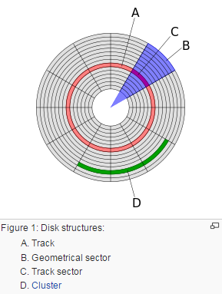
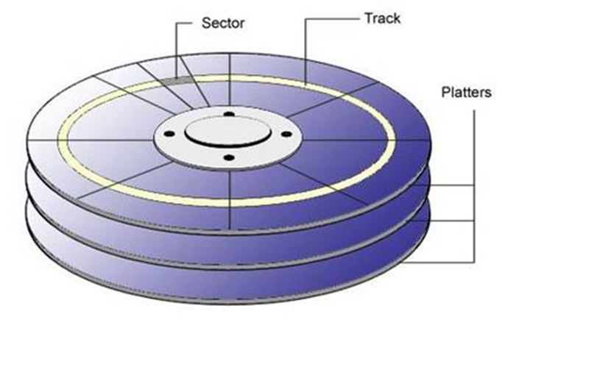
The sector is the minimum storage unit of a hard drive.
Each sector is made up of three basic parts, the sector header, the data area and the error-correcting code (ECC)
Operating systems typically operate on blocks of data, which may span multiple sectors
Block encompasses multiple sectors.

Slide 3
Assumptions:
The system can crash at any time
Power can go out at any point
Contents of the main memory won’t survive a crash!
BUT… harddissks are durable. They might stop, but data is not lost.
For now.
Disks only guarantee atomic sector writes, nothing more
Transactions are by themselves consistent
Goals:
Guaranteed durability, atomicity
As much concurrency as possible, while not compromising isolation and/or consistency
Two transactions updating the same account balance… NO
Two transactions updating different account balances… YES

Slide 4
Concurrent Executions
Multiple transactions should be allowed to run concurrently in the system.
Advantages are:
increased processor and disk utilization, leading to better transaction throughput
E.g. one transaction can be using the CPU while another is reading from or writing to the disk
reduced average response time for transactions: short transactions need not wait behind long ones.

Slide 5
Schedules
Schedule – a sequences of instructions that specify the chronological order in which instructions of concurrent transactions are executed
a schedule for a set of transactions must consist of all instructions of those transactions
must preserve the order in which the instructions appear in each individual transaction.
A transaction that successfully completes its execution will have a commit instructions as the last statement
A transaction that fails to successfully complete its execution will have an abort instruction as the last statement

Slide 6
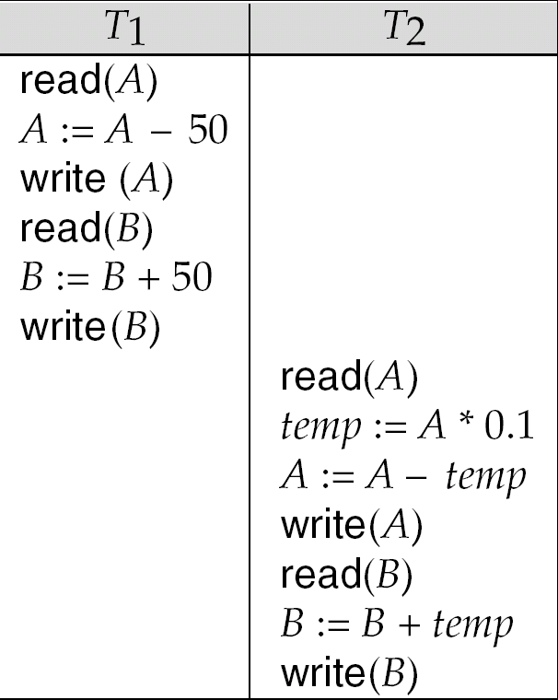
Schedule 1
Let T₁ transfer $50 from A to B, and T₂ transfer 10% of the balance from A to B.
A serial schedule in which T₁ is followed by T₂ :

Slide 7
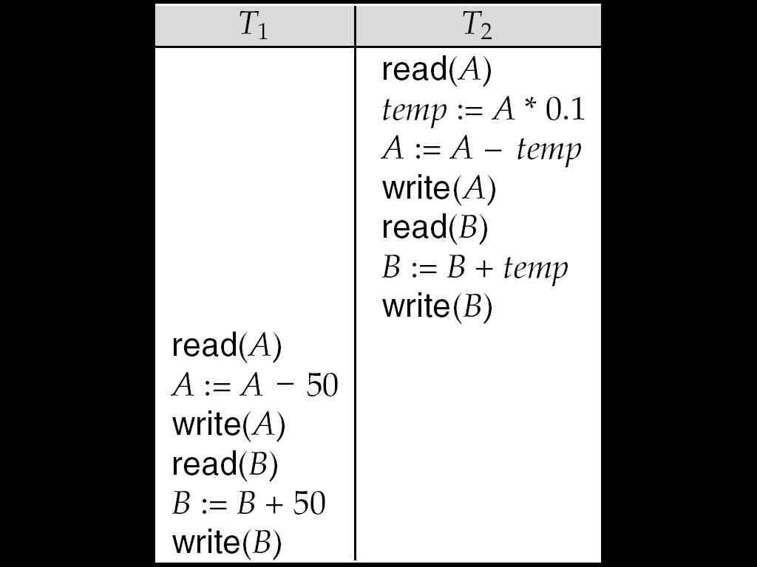
Schedule 2
A serial schedule where T₂ is followed by T₁

Slide 8
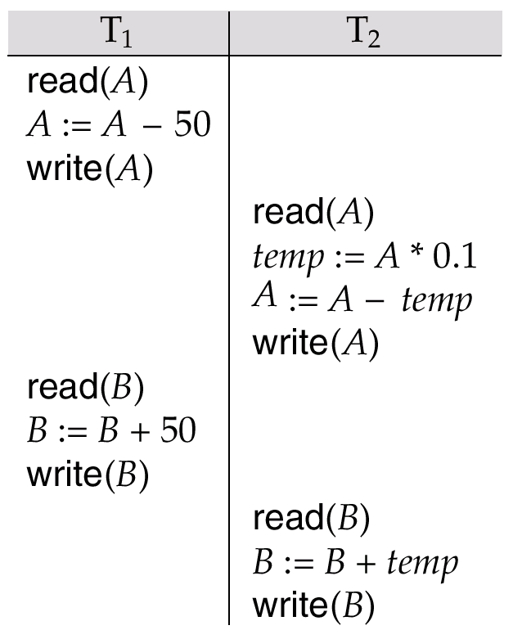
Schedule 3
Let T₁ and T₂ be the transactions defined previously. The following schedule is not a serial schedule, but it is equivalent to Schedule 1.
In Schedules 1, 2 and 3, the sum A + B is preserved.

Slide 9
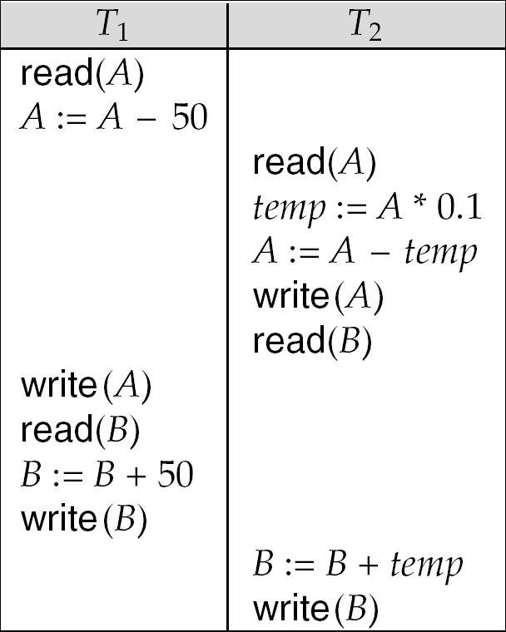
Schedule 4
The following concurrent schedule does not preserve the value of (A + B ).

Slide 10
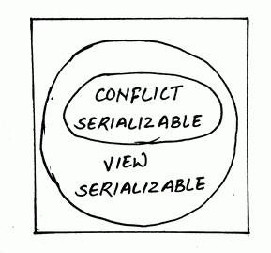
Serializability
Serial execution of a set of transactions preserves database consistency.
A schedule is serializable if it is equivalent to a serial schedule. Different forms of schedule equivalence give rise to the notions of:
1. conflict serializability
2. view serializability
Simplified view of transactions
We ignore operations other than read and write instructions
We assume that transactions may perform arbitrary computations on data in local buffers in between reads and writes.
Our simplified schedules consist of only read and write instructions.

Slide 11
Conflicting Instructions
Instructions l_{i} and l_{j} of transactions T_{i} and T_{j} respectively, conflict if and only if there exists some item Q accessed by both l_{i} and l_{j}, and at least one of these instructions wrote Q.
1. l_{i} = read(Q), l_{j} = read(Q). l_{i} and l_{j} don’t conflict. 2. l_{i} = read(Q), l_{j} = write(Q). They conflict. 3. l_{i} = write(Q), l_{j} = read(Q). They conflict 4. l_{i} = write(Q), l_{j} = write(Q). They conflict
Intuitively, a conflict between l_{i} and l_{j} forces a (logical) temporal order between them.
If l_{i} and l_{j} are consecutive in a schedule and they do not conflict, their results would remain the same even if they had been interchanged in the schedule.

Slide 12
Conflict Serializability
If a schedule S can be transformed into a schedule S´ by a series of swaps of non-conflicting instructions, we say that S and S´ are conflict equivalent.
We say that a schedule S is conflict serializable if it is conflict equivalent to a serial schedule

Slide 13
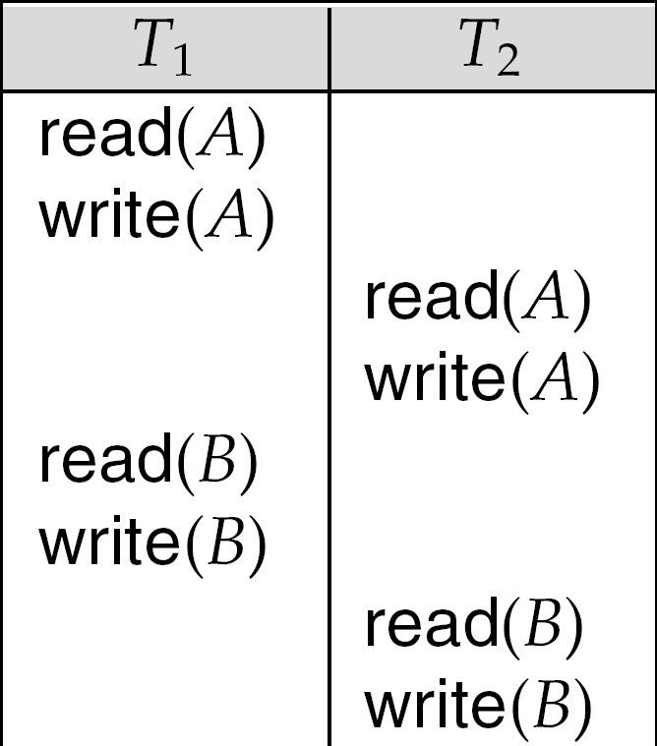
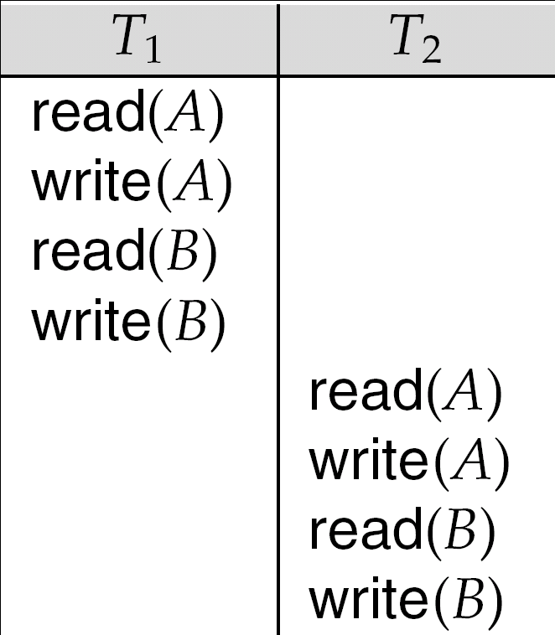
Conflict Serializability (Cont.)
Schedule 3 can be transformed into Schedule 6, a serial schedule where T₂ follows T₁, by series of swaps of non-conflicting instructions.
Therefore Schedule 3 is conflict serializable.
Schedule 3
Schedule 6

Slide 14
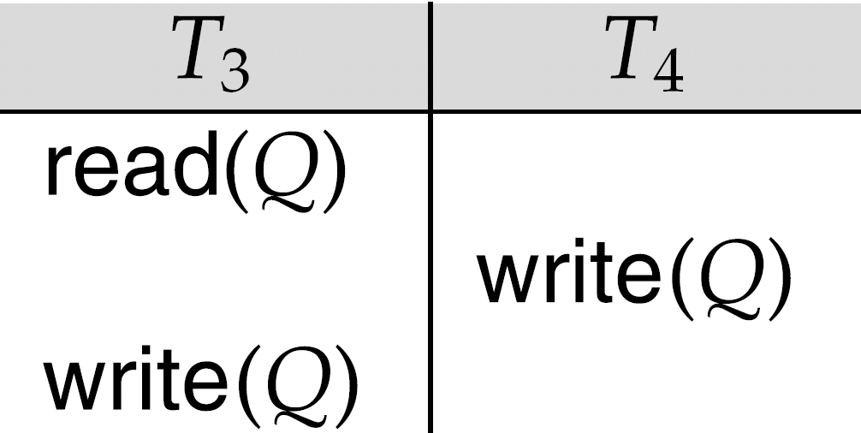
Conflict Serializability (Cont.)
Example of a schedule that is not conflict serializable:
We are unable to swap instructions in the above schedule to obtain either the serial schedule < T₃, T₄ >, or the serial schedule < T₄, T₃ >.

Slide 15
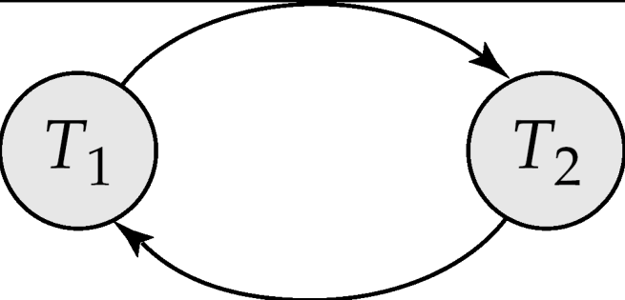
Testing for Serializability
Consider some schedule of a set of transactions T₁, T₂, ..., T_{n}
Precedence graph — a direct graph where the vertices are the transactions (names).
We draw an arc from T_{i} to T_{j} if the two transaction conflict, and T_{i} accessed the data item on which the conflict arose earlier.
We may label the arc by the item that was accessed.
Example 1
x
y

Slide 16
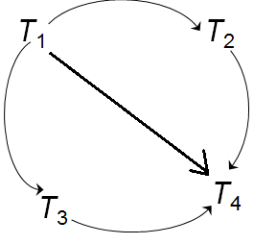
Example Schedule (Schedule A) + Precedence Graph
T₁ T₂ T₃ T₄ T₅ read(X) read(Y) read(Z) read(V) read(W) read(W) read(Y) write(Y) write(Z) read(U) read(Y) write(Y) read(Z) write(Z)
read(U) write(U)
T₅

Slide 17
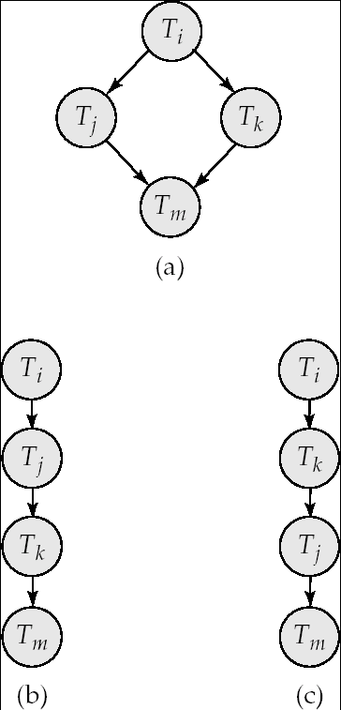
Test for Conflict Serializability
A schedule is conflict serializable if and only if its precedence graph is acyclic(contains no-cycles).
Cycle-detection algorithms exist which take order n² time, where n is the number of vertices in the graph.
(Better algorithms take order n + e where e is the number of edges.)
If precedence graph is acyclic, the serializability order can be obtained by a topological sorting of the graph.
This is a linear order consistent with the partial order of the graph.
For example, a serializability order for Schedule A would be T₅ → T₁ → T₃ → T₂ → T₄
Are there others?

